Slide 1

Comparison Between File-Based Systems and DBMS University Student Management System
Presented by
Rohith P (192572013)
CSA0506- DATABASE MANAGEMENT
TECHNICAL PRESENTATION

Slide 2
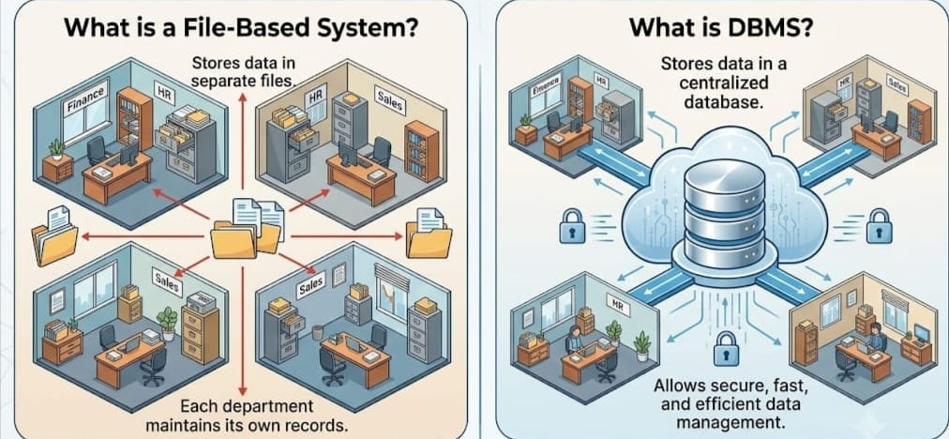
INTRODUCTION
What is a File-Based System?
Stores data in separate files.
Each department maintains its own records.
What is DBMS?
A Database Management System stores data in a centralized database.
Allows secure, fast, and efficient data management.

Slide 3
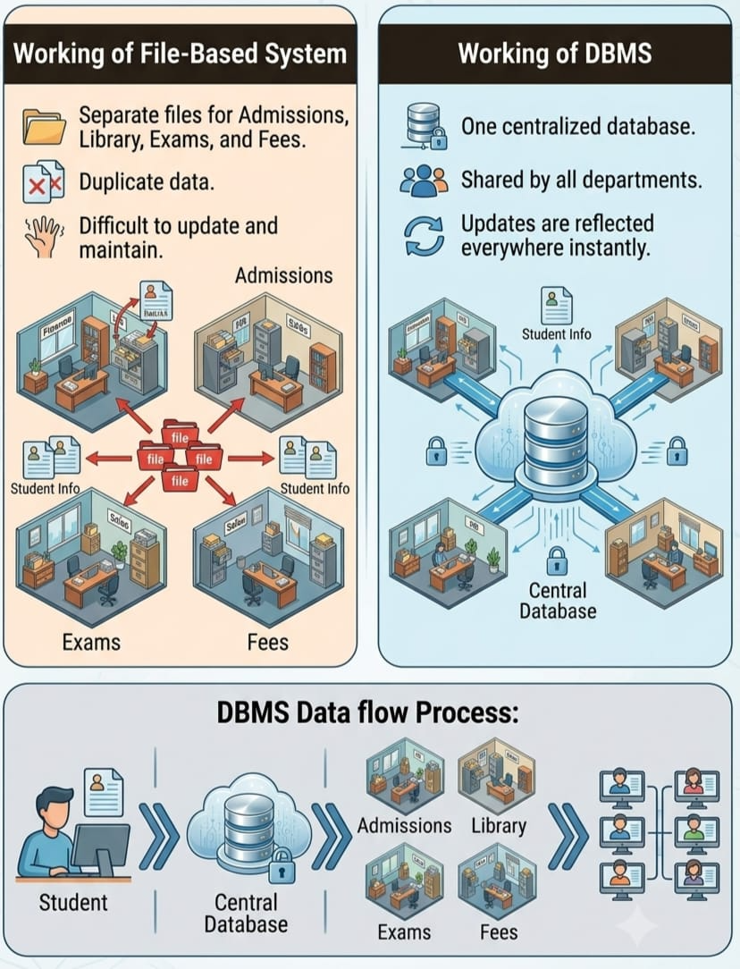
CORE TECHINICAL EXPLANATION
Working of File-Based System
Separate files for Admissions, Library, Exams, and Fees.
Duplicate data.
Difficult to update and maintain.
Working of DBMS
One centralized database.
Shared by all departments.
Updates are reflected everywhere instantly.
Process: Student Information → Central Database → Departments → Users

Slide 4
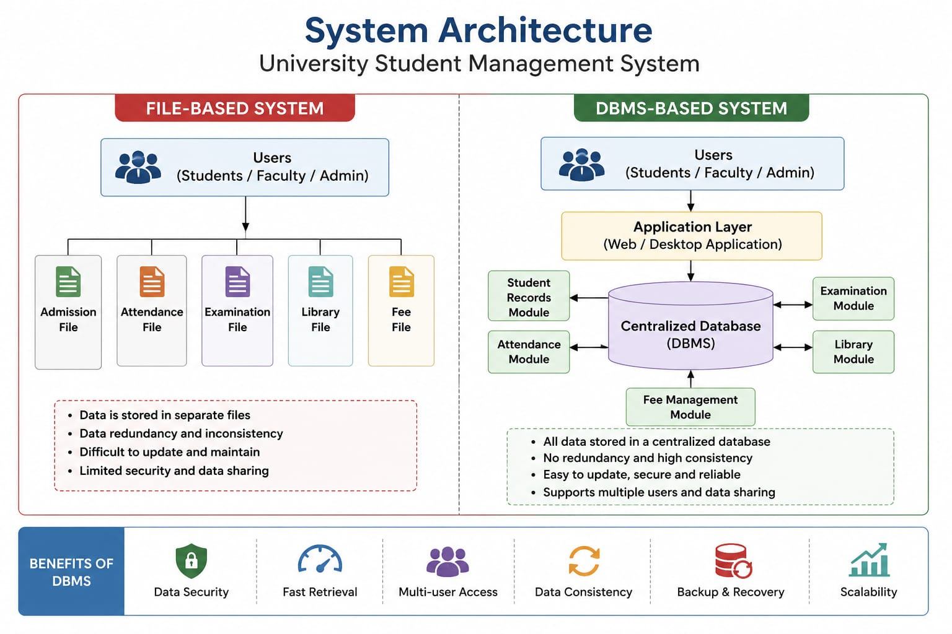

Slide 5
Real-Life Case Study
University Student Management System
Scenario: A student changes their mobile number.
File-Based System
Update Admissions
Update Library
Update Examination
Update Fee records
Missing one update causes inconsistent data.
DBMS
Update once in the central database.
All departments automatically receive the updated information.

Slide 6
CONCLUSION
DBMS is more efficient than a file-based system.
Eliminates duplicate data.
Improves accuracy and security.
Widely used in universities, schools, banks, hospitals, and businesses.

Slide 7
THANK
YOU

